Slide 1

Inventory Product Upload Guide

Slide 2

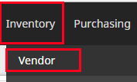
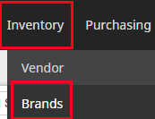
Vendor
Enter Vendor Information.
Inventory>Vendor> Click (Add) to create vendor on the top right.
You fill in only the red * parts
Site: leave it as it is (it’s already setup)
Vendor Name: put the name of the vendor
Vendor User: Click Create New User to add a new vendor.
On the User info page- change the Account Level to Vendor (first line)
and fill in the rest of red * parts
Click Save on the Bottom
Brand
Enter Brand Information.
Inventory>Brand> Click (Add) to create brand on the top right.
You fill in only the red * parts
Site: leave it as it is (it’s already setup)
Vendor : choose one vendor
Brand Name: put brand name
Click Save on the Bottom

Slide 3
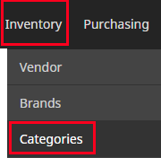
Category
Setup your Category
Inventory>Category> Click (Add) to create category on the top right
You fill in only the red * parts
Needed entries
Name: put category name
Classification Code and Type: leave it as it is (auto category code)
Subcategory Of : create a Root category(main category) or find categories you need to put under.
(You can select multiple categories)
Click Add to create

Slide 4
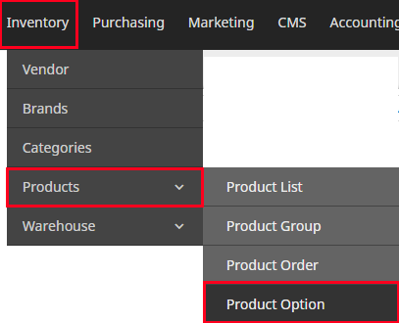
Inventory
Product Options
Products

Slide 5
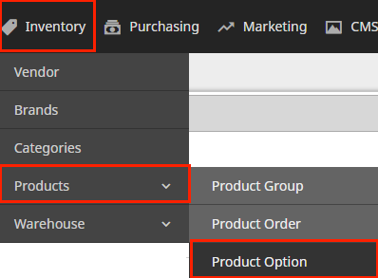
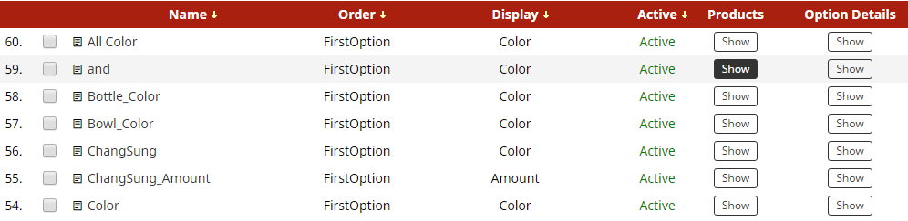
Product Options –
Add Options First before adding products
Inventory – Product Option (First Screen)

Slide 6

Product Options Add
Inventory > Product Option is on the lower right. Click (Add Button) to create Option
****Able to use the same option repeatedly for other products once setup.
Show In Amazon

Slide 7
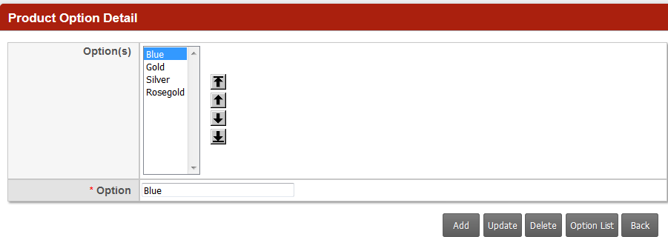
Name: Name of Option
Products: Show Button - Show Related Products that are using this option.
Option Details: Show button – Show Option Detail page (See below) You can add or modify Each Color.
Option: Add each option name one by one Ex) red -> Add , yellow-> Add

Slide 8
Product Upload
Inventory>Product> Click on + (Add) to create on the lower bottom
You fill in only the red * parts that applies to you.
Will explain only the parts that are needed extra info and exclude the self explanatory parts.
General
Sites: Already selected
Name: Name of Product Product ID/ SKU : Product SKU number
UPC: UPC code used for Amazon
Item Name: Your own product name (if any) of above SKU# for inter-office use only
Brand : Select one brand for the product.
Category: Check the boxes where (which category) you need to put under.
Price: Original Price(MSRP) Offer Price(Sale Price) / Dealer Price(Wholesale Price) store cost( vendor’s price)
Smart Upload: Use 1 LARGE image and it will automatically adjust sizes for small and medium sizes.
Qty in stock: Actual # of inventory
Detail: Enter in the weight and sizes
Priority: Give Priority No.1 and it will stay on the front top. (so leave it on priority No 5 for other products)
Same Day Shipping: Check if this product is same day shipping.
Description
SEO Tile: SEO Keywords: SEO Description: Put necessary info to make the products exposed in Google. This is how you want your customers to find your product so be specific in describing your products.
Features and Description: This will display on the lower side of product detail page.
Description— Description Tap -> Long Description
Advanced
Image Alt: Enter the image description; this will show up when you hover mouse on the image
Meta Keywords: Keywords for users to find the products within the website.
Disregard the rest.

Slide 9
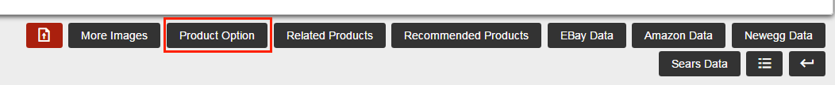
Set Product Option
Set your option per each product after adding a product.
Use product options that you already created on the previous page.
(Click below Product Option on the bottom of Product page)
To set Option for each products
Go to Inventory>Product>Click one product> Click Product Option button (next to more images)
This will display the types of options you chose from above product option page.

Slide 10
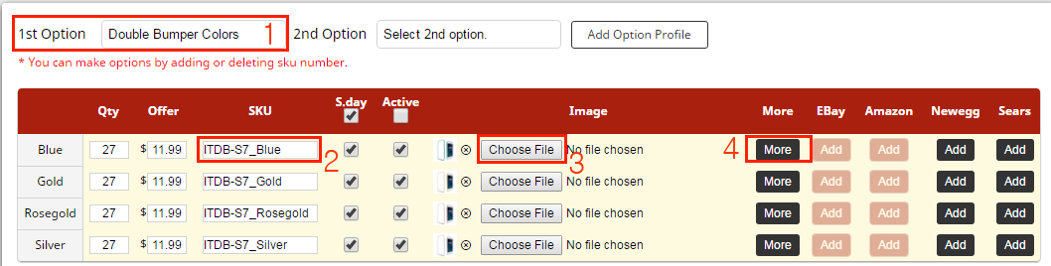

Add Product Option
Select 1 Option that you created previously. (Refer to Product option page 6-7)
Able to select 2 Options in case you need 2nd options. (color and size) Use 2nd Option for extra option.
2. Enter SKU# per each option (cannot be duplicate)
Upload a main image
Then click SAVE
Then you will see the more image button showing.
Option’s more images:
Go to next page for detail to upload more images for
each option.

Slide 11
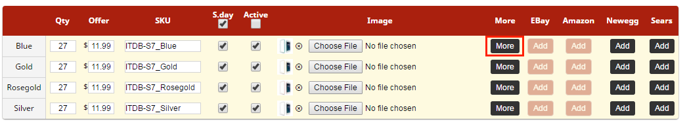
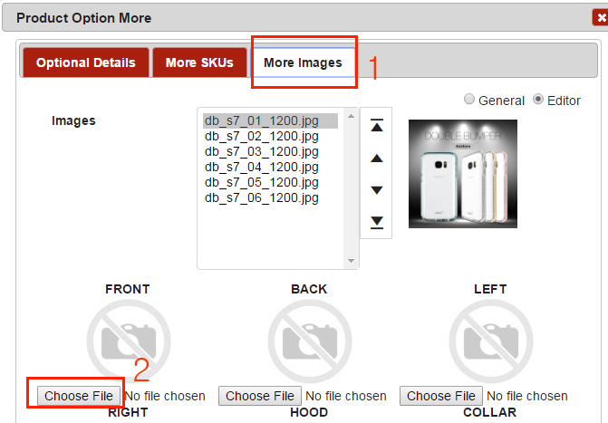
Enter Product Option - More Image per Color
More Button is created after you upload the main color option image
This is used only if you have color option.
1. Click More Image Button
2. Upload image
and Save
File name should be only in English.

Slide 12
Enter UPC Code
Enter UPC Code after clicking More Button on the same screen.
Click More Image Button
Enter UPC code
Save

